Slide 1

Exploration of Attrition MSDS Consulting Group Sakava Kiv
Notes:
Good Evening,
Tonight, were going to talk about Employee Turnover or Attrition. I am Sakava Kiv, a Data Scientists who is an expert at helping companies prosper . As you know, the snack industry is a highly competitive and a rapidly evolving market, with a wide range of factors that can impact a company's success. At MSDS Consulting group, we specialize in leveraging data science to help companies make more informed decisions, drive innovation, and stay ahead of their respective industries. Tonight, I'd like to share insights we've gathered from years' worth of data analysis on Frito Lay and what we discovered about the attrition here.

Slide 2
Main topics
We will analyze features for reasons behind Attrition of Employees.
We will Identify the top three factors that lead to employee attrition.
We go over a model that predicts attrition.
Notes:
Read Bullet points

Slide 3
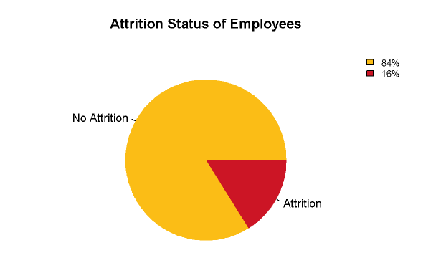
Attrition Distribution
No | Yes
730 | 140
Notes:
Attrition is the value we are targeting. And the quantity of data of employees having Attrition is less compared to employees which do not have Attrition. So from the pie chart, we can see that of the 870 employee 16% left their job due to some reason, but 84% of the employees are still working at the company.

Slide 4
Features
Numerical | Categorical
27 | 9
Notes:
The features we explored and we will go over a few, are found to be 27 numerical and 9 categorical features.
For example numerical would be data such as Age, Monthly Income, Education, EnvironmentalSatisfaction, Job Involvement, JobLevel.
And For Categorical to name a few we have Business Travel, Department, Education Field, Gender, Marital Status, Job Role, and overtime.

Slide 5
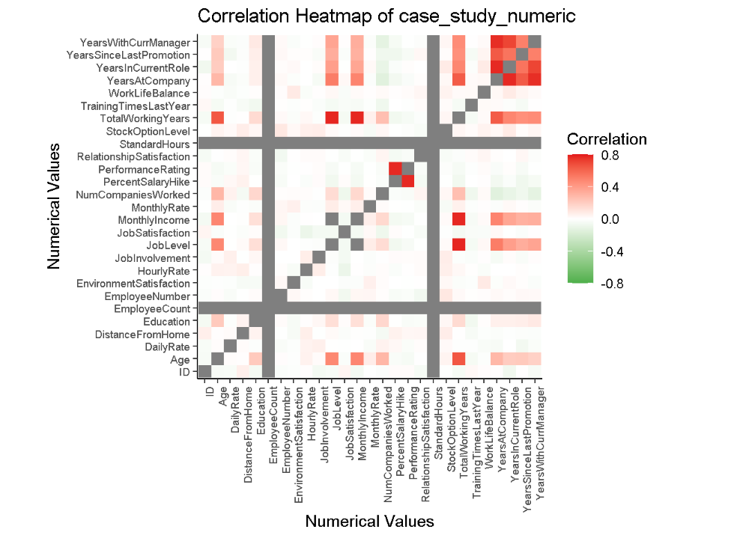
Heat Map of Numerical Data
Notes:
JobLevel appears to be a crucial feature and you better believe we’ll be delving deeper into it with some exploratory analysis.
Brace yourself, because we discovered some positively correlated relationships: TotalWorkingYears has a positive relationship with both JobLevel and MonthlyIncome indicated by the dark shade of red.
And that’s not all folks, we also found a positive relationship between YearsAtCompany with both YearsInCurrentRole and YearsWithCurrentManager.

Slide 6
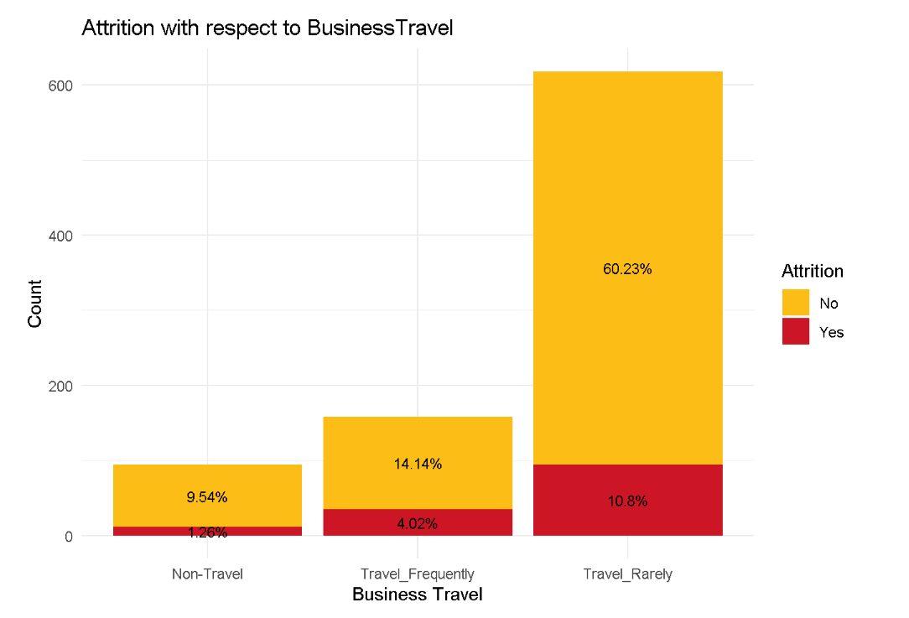
Analysis of Categorical Features
Notes:
There are more employees who travel very rarely, and the number of Attrition of such employees are greater which consist of 10.8% . So employees who get less chance to travel may need to be given surveys to see if they want to travel to reduce attrition rate here.

Slide 7
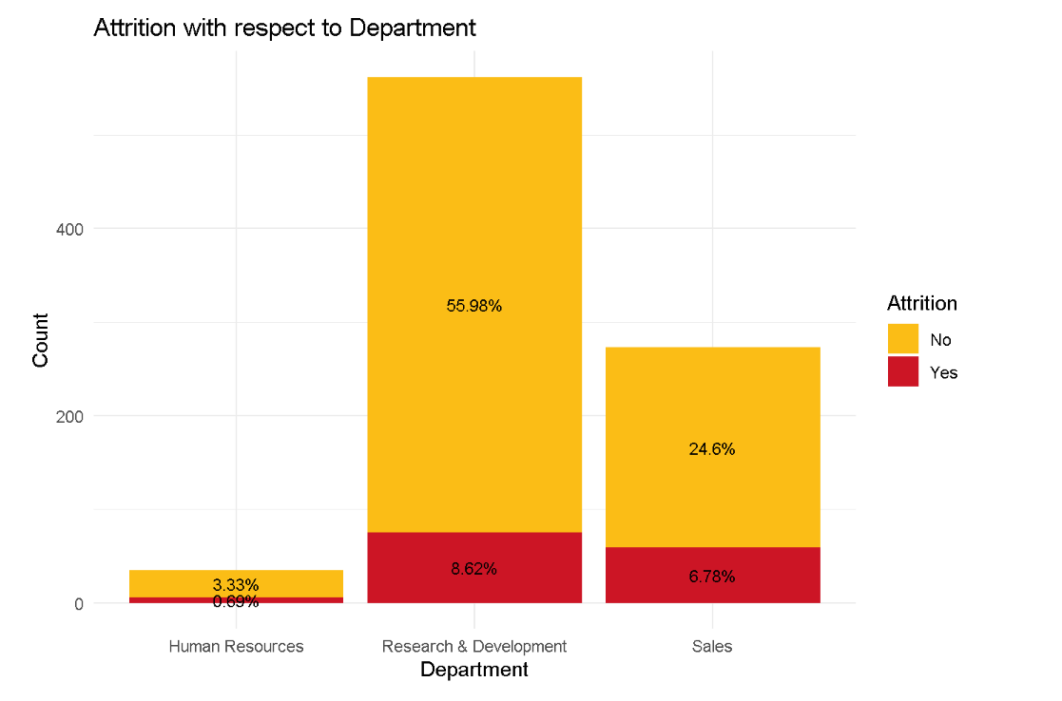
Analysis of Categorical Features
Notes:
Employees working in R&D department are the biggest population, but employees from sales department or in positions like sales executive or sale Representative leave the job early. We see 6.78 percent Attrition with respect to Sales making up around 31 percent of the employees here, which is interesting.

Slide 8
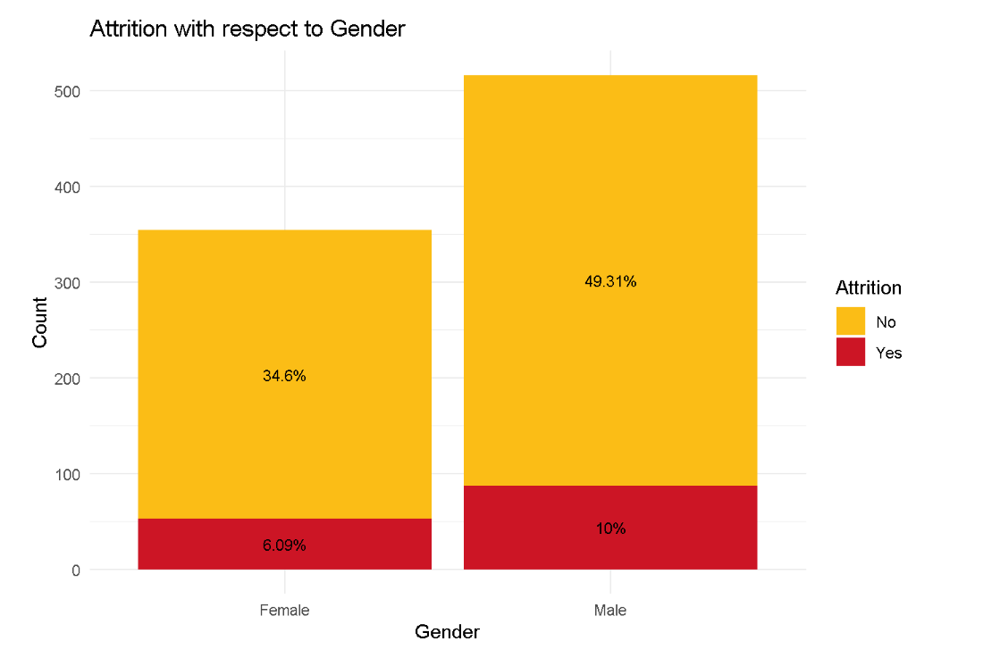
Analysis of Categorical Features
Notes:
We can observe here that Males make up more of the employees here and also make up a higher attrition percentage of 10 percent with respect to around 59 percent of males making up the employees here.

Slide 9
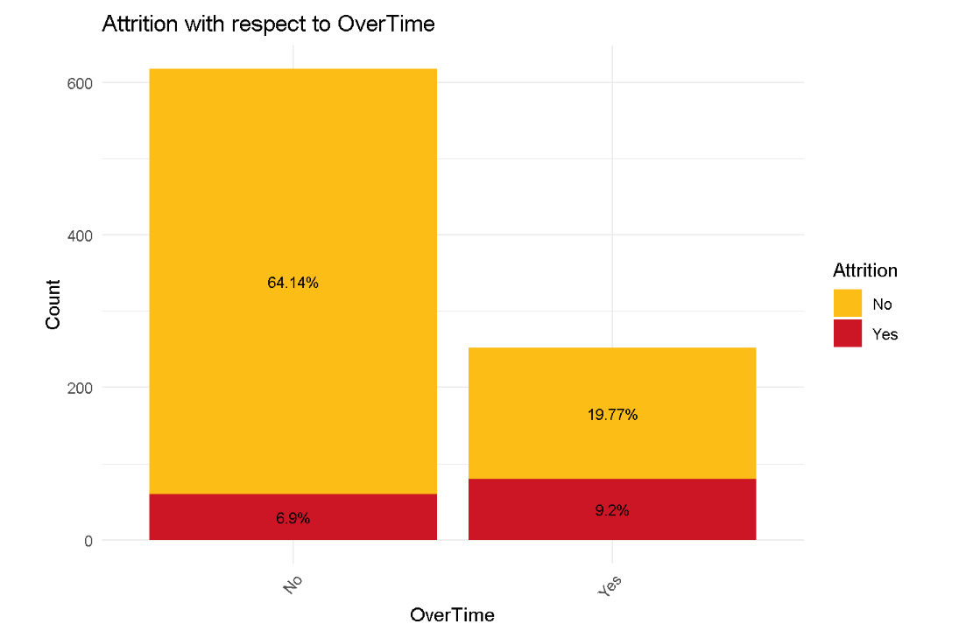
Analysis of Categorical Features
Notes:
We can see from this bar graph that if an employee is working overtime there is a significant amount of Attrition that happens we can see here 9.2 percent

Slide 10
Analysis of Categorical Features
 | Female | Male
No | 252 | 366
Yes | 102 | 150
Notes:
We can further see that More Males at 150 vs 102 females are working overtime.

Slide 11
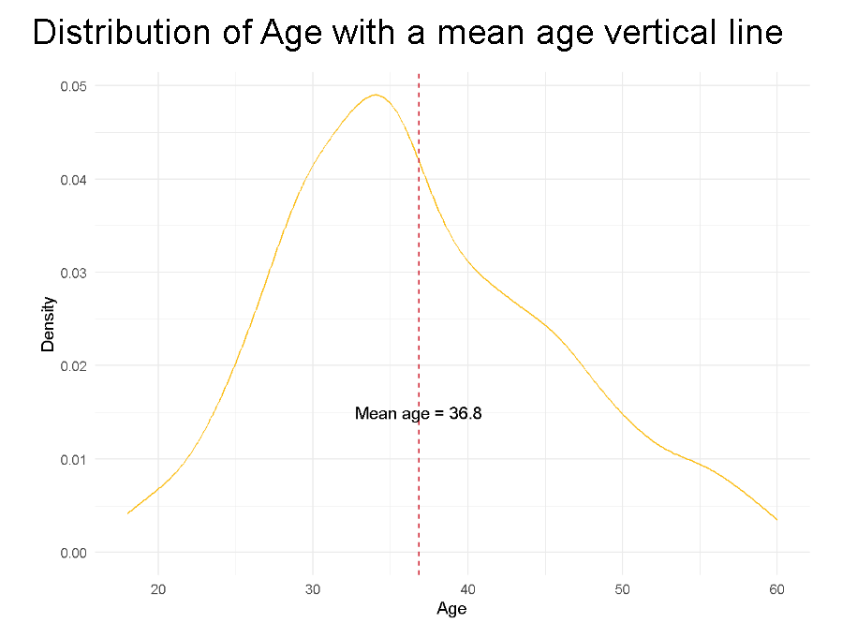
Analysis of Numerical Features
Notes:
Here we can see the mean age is 36.8 and we can see that this distribution of ages is normal.

Slide 12
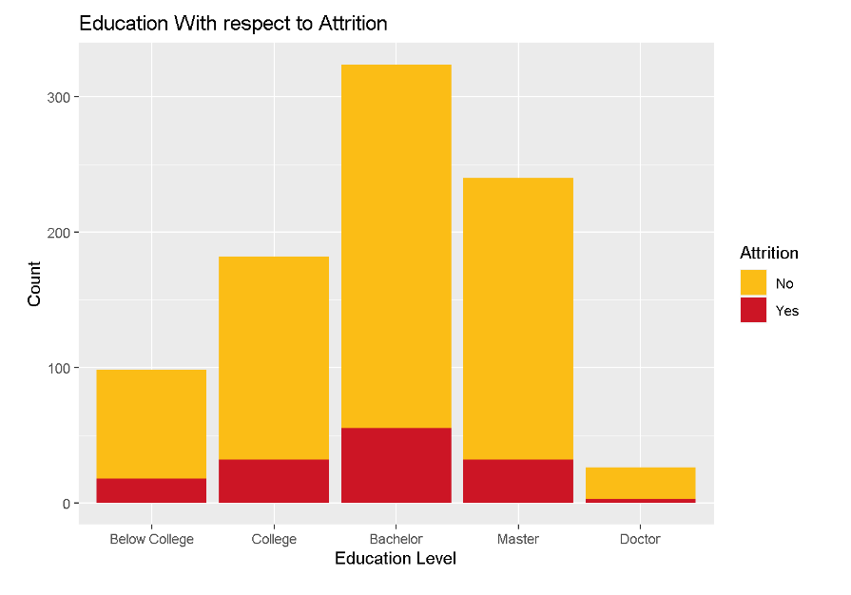
Analysis of Numerical Features
Notes:
There are more Employees with Bachelor degrees than other education levels. Attrition with respect to bachelor might have more expectations from the company, possibly more overtime is related.

Slide 13
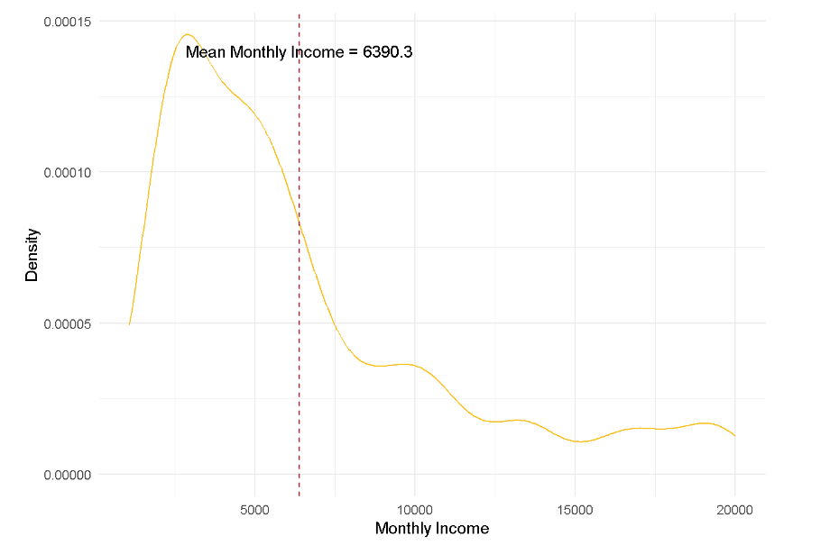
Analysis of Numerical Features
Notes:
Here we can observe the mean monthly income at 6390.30 of employees

Slide 14
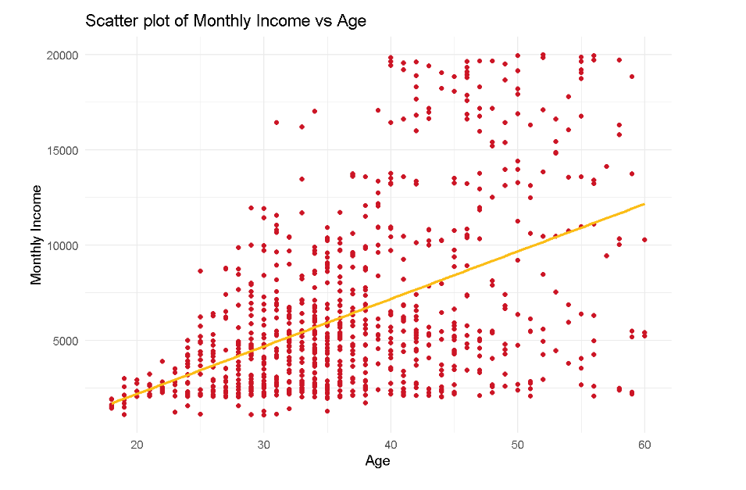
Analysis of Numerical Features
Notes:
There seems to be a positive linear relationship. As age and experience increases so does income.

Slide 15
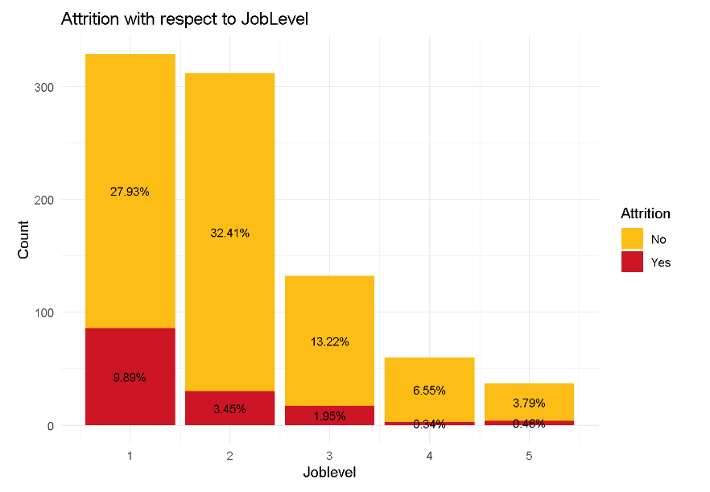
Analysis of Numerical Features
Notes:
Here we see a Significant amount of attrition for job level one, this could be related to new employees and one with out much experience so Age and income could be a factor here as well.

Slide 16
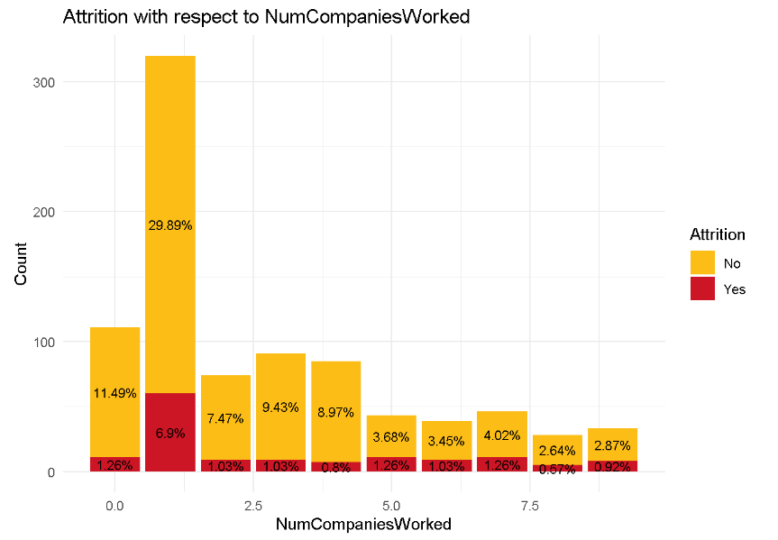
Analysis of Numerical Features
Notes:
Also we see that people who worked around 1 year tend to have turnover. Most likely they are newer employees and younger so again this can be again tied back to age and income.

Slide 17
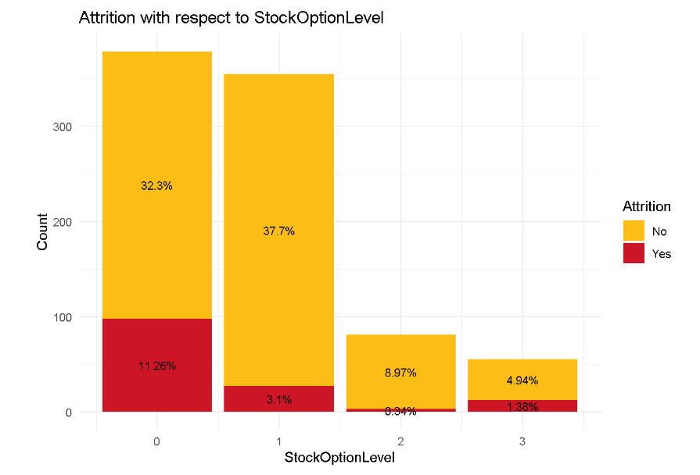
Analysis of Numerical Features
Notes:
Moreover we can see that those with 0 stock option level have a higher attrition rate. Again age, experience and income are probably related here as well for those who get the stock option level of 1, 2, and 3. usually stock option goes to leadership or more senior executive level folks. So again age and experience and income level can be related here.

Slide 18
Factors Responsible for Employee Attrition
OverTime has highest relationship with Attrition. Employee who do OverTime are more likely to change or leave the Job early. We observed this as well during categorical variable analysis.
Age is second highest factor, as those who are senior are retiring or the employees who have bachelor's degree have more expectations from the organization and may feel burned out.
MonthlyIncome is third factor for employee to Attrition

Slide 19
Modeling with K Nearest Neighbors
With the model for Oversampling when k = 3 we have a model that predicts Attrition around 86% with Sensitivity of around 72% and Specificity of around 99%.
We used Age and Monthly Income to predict attrition since as we saw earlier these two numerical values on their own are tied with so many other numerical and categorical variables.
Notes:
With the model for Oversampling when k = 3 we have a model that predicts Attrition around 86% with Sensitivity of around 72% and Specificity of around 99%.

Slide 20
THANK YOU MSDS Consulting Group Sakava Kiv Email: skiv@smu.edu
Notes:
Ending Slide
Now, Thank you for joining me today for this presentation. Again, my name is Sakava Kiv representing the MSDS Consulting Group and I hope you found it informative and engaging.
If you have any further questions or would like to discuss the topics covered in more detail, please don't hesitate to reach out to me.
You can contact me via email at skiv@smu.edu
Thank you again for your time and attention. Have a great evening!

